Slide 1

Mobility Strategy
Barbara Surdykowska

Slide 2
Milestones for a smart and sustainable future
By 2030
at least 30 million zero-emission cars will be in operation on European roads
100 European cities will be climate neutral.
high-speed rail traffic will double across Europe
scheduled collective travel for journeys under 500 km should be carbon neutral
automated mobility will be deployed at large scale
zero-emission marine vessels will be market-ready

Slide 3
Milestones for a smart and sustainable future
By 2035
zero-emission large aircraft will be market-ready

Slide 4
Milestones for a smart and sustainable future
By 2050
nearly all cars, vans, buses as well as new heavy-duty vehicles will be zero-emission.
rail freight traffic will double.
a fully operational, multimodal Trans-European Transport Network (TEN-T) for sustainable and smart transport with high speed connectivity.

Slide 5
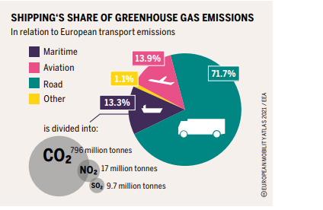

Slide 6
10 key areas for action to make the vision a reality
To make our goals a reality, the strategy identifies a total of 82 initiatives in 10 key areas for action (“flagships”), each with concrete measures.

Slide 7
Sustainable
For transport to become sustainable, in practice this means:
Boosting the uptake of zero-emission vehicles, vessels and aeroplanes, renewable & low-carbon fuels and related infrastructure - for instance by installing 3 million public charging points by 2030.
Creating zero-emission airports and ports – for instance through new initiatives to promote sustainable aviation and maritime fuels.
Making interurban and urban mobility healthy and sustainable - for instance by doubling high-speed rail traffic and developing extra cycling infrastructure over the next 10 years.
Greening freight transport – for instance by doubling rail freight traffic by 2050.
Pricing carbon and providing better incentives for users – for instance by pursuing a comprehensive set of measures to deliver fair and efficient pricing across all transport.

Slide 8
Smart
Innovation and digitalisation will shape how passengers and freight move around in the future if the right conditions are put in place. The strategy foresees:
Making connected and automated multimodal mobility a reality – for instance by making it possible for passengers to buy tickets for multimodal journeys and freight to seamlessly switch between transport modes.
Boosting innovation and the use of data and artificial intelligence (AI) for smarter mobility – for instance by fully supporting the deployment of drones and unmanned aircraft and further actions to build a European Common Mobility Data Space.

Slide 9
Resilient
Transport has been one of the sectors hit hardest by the COVID-19 pandemic, and many businesses in the sector are seeing immense operational and financial difficulties. The Commission therefore commits to:
Reinforce the Single Market - for instance through reinforcing efforts and investments to complete the Trans-European Transport Network (TEN-T) by 2030 and support the sector to build back better through increased investments, both public and private, in the modernisation of fleets in all modes.
Make mobility fair and just for all – for instance by making the new mobility affordable and accessible in all regions and for all passengers including those with reduced mobility and making the sector more attractive for workers.
Step up transport safety and security across all modes - including by bringing the death toll close to zero by 2050.

Slide 10


Slide 11
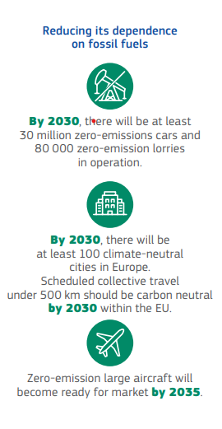

Slide 12
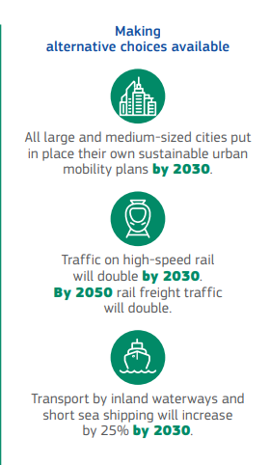

Slide 13
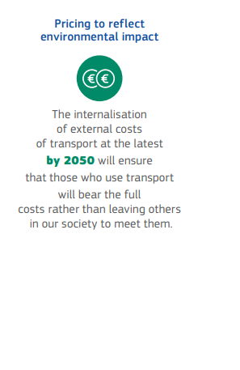

Slide 14
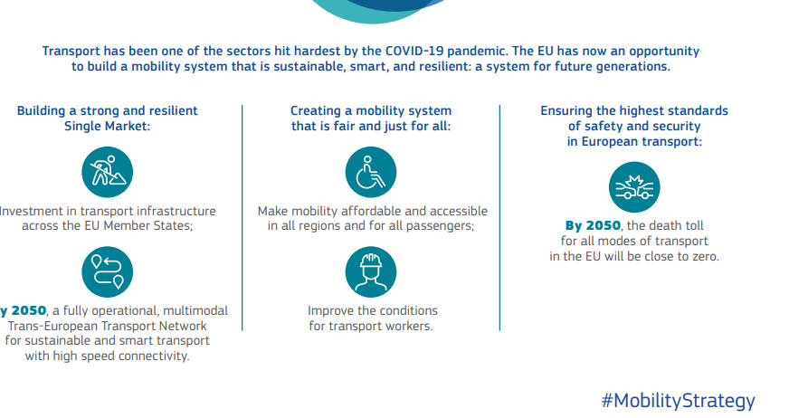

Slide 16
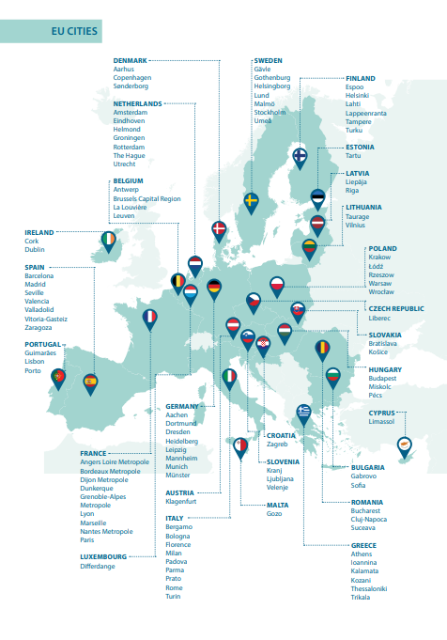

Slide 17
Workers basic statistic
In the EU-27, approximately 10 million persons are employed in the transport and storage services sector (including postal and courier activities), which represents 5.2 % of the total workforce.
Approximately 53 % of them work in land transport (road, rail and pipelines), 3 % in water transport (sea and inland waterways), 4 % in air transport, 26 % in warehousing and supporting and transport activities (such as cargo handling, storage and warehousing), and the remaining 14 % in postal and courier activities.
Women are underrepresented in the EU’s transport sector’s workforce (22 %).
An analysis by age of the EU transport workforce in 2015 shows that the share for persons aged 30-49 years was similar to that for the whole economy, but the share of older workers was higher in the transport sector (36.9 % are aged 50-64 years), while the share of younger workers was lower (12.1 % are aged 15-29 years).

Slide 18
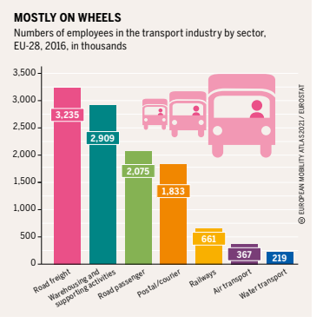

Slide 19
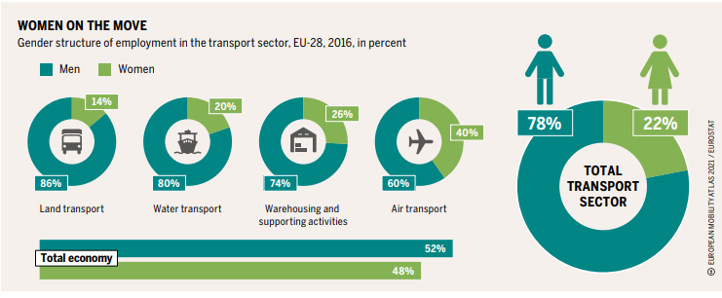

Slide 20
Road transport
Road transport consists of various transport modes: private cars, taxi, bicycles, light commercial and heavy-duty vehicles (LCVs and HDVs), city buses and long-distance coaches. Road transport is essential to the economy in terms of its contribution to GDP as well as employment.
The modal share of commercial road transport in 2021 was 54% in freight and 78% in passenger transport. The sector employs around 5.2 million people in the EU and therefore is by far the single largest transport sector in terms of employment. With an employment growth rate of more than 15% between 2012 and 2020, road transport also experienced the strongest growth in terms of employment of all transport modes.

Slide 21
Road transport
The average age of truck drivers is high with more than one third of them being over 55.4 There is a low share of young drivers under 25 years of age (6% for freight and 5% for passenger transport), despite high youth unemployment in many countries.
Women also make up only a small percentage of truck drivers, despite significant levels of female unemployment in some countries. Spain, for example, has one of Europe’s highest rates of female unemployment (14%), yet one of the lowest shares of female truck drivers (2%), in contrast to a comparable share of female bus and coach drivers (12%)
According to data gathered by the International Road Transport Union (IRU), without action to make the driver profession more attractive, the EU could lack over 2 million drivers by 2026, impacting half of all freight movements and millions of passenger journeys.

Slide 22
Road transport
Emerging from results of a recent IRU company survey, more than 82% of bus and coach companies in Europe have severe or very severe difficulties to fill in driver positions. For 2023, the IRU estimates that 105,000 bus and coach driver jobs are unfilled in Europe.

Slide 23
Mobility-as-aService (MaaS) and Transport-as-a-Service (TaaS)
During the past decade and triggered by a combination of different societal, technological and other factors (e.g. the Covid-19 crisis), new services and business models in urban mobility and logistics have emerged that have created new business and employment opportunities around Mobility-as-aService (MaaS) and Transport-as-a-Service (TaaS): digital platforms and apps for existing and new mobility offers, platforms for freight exchange or on-demand ride-hailing services; by car and cycle sharing, ride hailing services, ride-sharing, electric scooters, etc

Slide 24
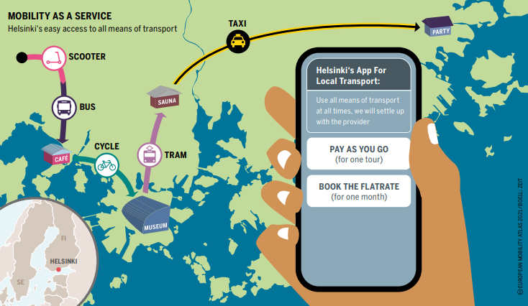
Mobility-as-aService

Slide 25
Public/Private
As highlighted in a recent research report, the old dichotomy between private and public transport already has become blurred and may disappear in the future, because automated on-demand services are flexible and more geared to individual needs than conventional public transport services. Thus, also from the perspective of policy making and regulation there might be a need to address a situation where "private transport becomes public while public transport becomes private." (Weert & Knie, 2023)
Weert, C. & Knie, A., 2023. The Future of Mobility. Winners and Losers and New Options in the Public Space. WZB ed. Berlin: WZB Discussion Paper, SP III 2023-601.

Slide 26
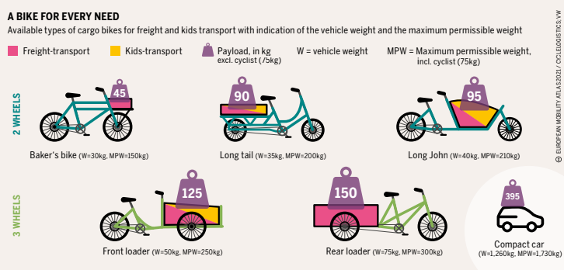

Slide 27
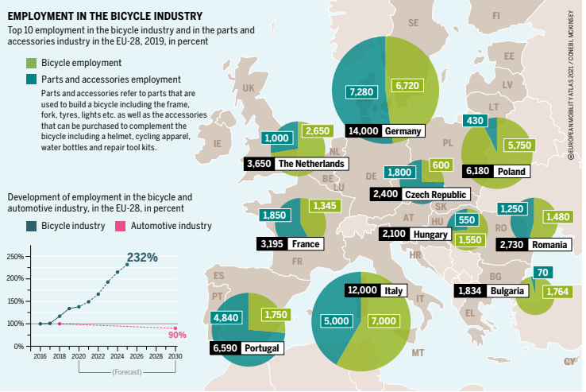

Slide 28
Road transport
Road transport
Measures need to be taken to stop exploitative labour practices in the sector, which affect in particular workers from Eastern European and third countries. Steps also need to be taken to improve the attractiveness of the sector to the younger generation and to women: in the case of bus and coach driver jobs, the labour shortage is now urgent.

Slide 29
Rail transport
According to the latest available EU data, there were 910,000 people employed in the EU27 railway sector in 2020. According to data gathered in the context of the EU Rail Market Monitoring (RMMS), employment in railways between 2015 and 2020 increased most strongly in France and Germany, more moderately in Austria, Belgium, Sweden, and Norway but stagnated or decreased in 20 of the EU28 Member States.

Slide 30

Rail transport
Key challenges of the railway sector are linked to the expectation of expanding rail transport volumes and extension of high-speed lines, long-distance cross-border railways and digitalisation of command control and signalling (i.e. ETCS and ERTMS) as the key enabling technology for the Single European Railway Area.
First, if the objective is to give the railway sector the strategic role it deserves for the green transition of transport, the current infrastructure needs to be extended and modernised.
As highlighted by CER, the existing infrastructure in freight and passenger rail is not matching the current demand and this is not taking into account the requirements in relation to EU goals of expansion of high-speed railways and rail freight transport.

Slide 31

Rail transport
However, according to the most recent statistics from the European Commission, the total length of railway lines in use in the European Union in 2020 was 200,099 km while it was 204,149 km in 2010.

Slide 32
European Social dialogue
The ETF and CER have carried out joint studies and decided, in 2018, to enter negotiations to establish an autonomous agreement aimed at promoting employment of women in the rail sector. The Autonomous Agreement on Women in Rail was officially signed in November 2021. This agreement aims to attract more women to the rail sector, give women more protection and guarantee equal treatment in the workplace thanks to measures agreed under the headlines of general gender equality policy, which cover areas such as, targets, how to attract more women to the sector, reconciliating work and private life, promotion and career development, equal pay, health and safety and work environment and prevention of sexual harassment and discrimination based on gender. The agreement is the first of its kind in transport and has a binding character: it entered into force upon signing and companies had 24 months to establish a gender and diversity policy at the company level. The agreement will be reassessed by ETF and CER in 2024/2025.

Slide 33
Air transport
For the ground handling sector, the stakeholders stressed a lack of attractiveness and retention of the occupation as major challenges. The competition in this sector means that the jobs tend towards being precarious and temporary as employers compete on costs.
Moreover, the sector is not yet properly regulated at international level and, in the current situation, the market relies on (i) own industry standards47 and (ii) Directive 96/67/EC on access to the ground handling market at airports. The stakeholders expressed the need for a dedicated Regulation on minimum levels of working conditions. Another challenge for the ground handling sector is the retention of workers; in particular, young workers change jobs more quickly than was previously the case, because these occupations need low-skilled personnel and is organised in day and night shifts.
The emerging challenge for ground handlers is to find the balance between the provision of services to airlines at competitive prices and accommodate airports’ needs to invest in equipment that make the infrastructure compliant with the ESG.

Slide 34
Air transport
According to Eurostat data, in 2020, the total number of workers was around 900,000 for the four sectors classified by the European database as linked to air transport, namely (i) air passenger, air freight and space transport, (ii) service activities incidental to air transport, (iii) renting and leasing of air transport equipment and (iv) manufacture of air and spacecraft and related machinery.

Slide 35
aviation industry is evolving
The aviation industry is evolving and its modernisation is key to meeting environmental targets. Future workers will need skills in information technology, data management, cybersecurity, and communication to adapt to new business and operating models.
Air transport
In the light of new working conditions, policy makers should continue to monitor employment relationships of pilots and cabin crews that are based on alternative employment and temporary work, via intermediaries, such as temporary employment agencies.
Working conditions of ground handlers are not properly regulated at EU level. Policy makers should therefore consider a dedicated Regulation on minimum levels of working conditions.

Slide 36

Maritime transport
Maritime transport is a global industry predominantly focused on freight, being around 80% of the cargos seaborne.
Nowadays, three-quarters of goods are dry cargos (i.e., bulk and containers) and the world’s largest flows carried are between China and the USA, and their neighbouring countries.
For the EU’s economy, maritime transport fulfils a key role, representing three-quarters of the external trade and one-third of its intra-EU movements.
Maritime transport also plays a key role for passenger transport, especially to connect island regions, with 400 million passengers embarked and disembarked in EU ports on annual basis.

Slide 37
Maritame sector
The maritime sector is undergoing significant transformation, with new greening technologies applied to ships and automation increasingly applied in terminals. The need for transversal skills is growing, but automation and digitalisation will make the profile of maritime worker more appealing and provide opportunities for gender diversity.
Inland waterway transport has potential to enhance multimodal transport and improve environmental performance. However, ensuring sustainable growth requires an adequately trained workforce
Maritime transport
Policymakers should also consider amending EU legislation on social security in order to create a level playing field with shore workers.

Slide 38

Maritime sector
For the ports, European Commission data report 1.5 million workers directly employed and the same number indirectly employed across 22 Member States operating maritime transport activities. For the seafarers, EMSA’s statistics of 2021 report a population of 182,000 workers at EU level.
As noted by stakeholders, the ageing of the seafarers is not currently a problem. EMSA’s data show an average age of 44.3 years with a relatively even distribution by group, each between 18,000 and 28,000 workers (i.e., 10-15% of the total). In terms of the gender breakdown, seafarers are predominantly male (97.6%).

Slide 39
Inland waterways transport
The inland waterway transport sector is a relatively small sector with around 48,000 employees EU wide. The sector is also unique for the geographical scope. Approximately 65% of the people employed in the sector work in the basin of the Rhine River.
The sector is expected to change significantly over the coming decades, since it should play a pivotal role in the transition to zero-emission transport and mobility. However, the current inland fleet is relatively old and poorly equipped to facilitate this transition.

Slide 40
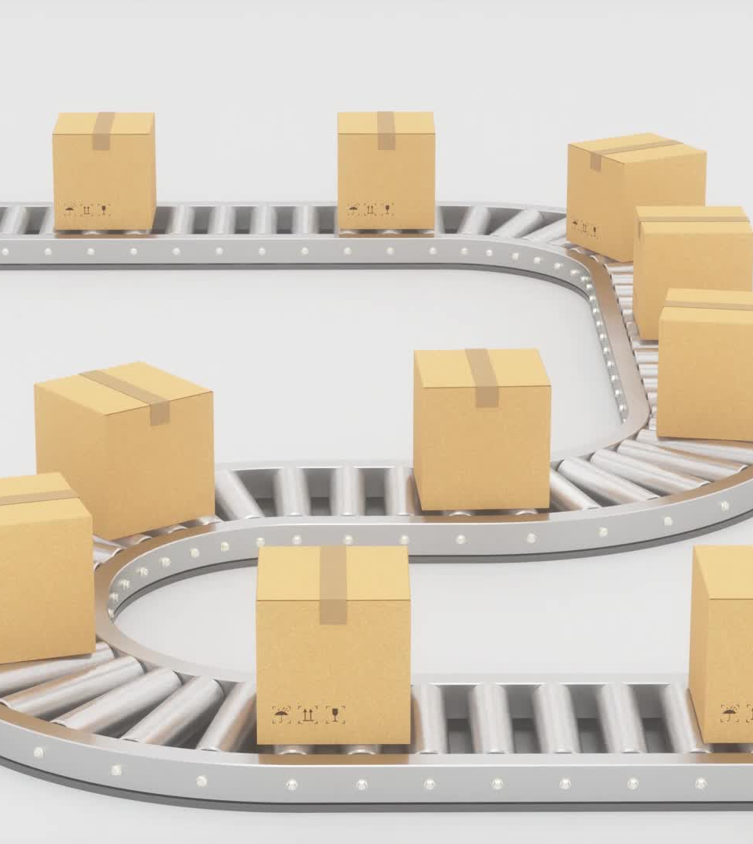
The emergence of new services in the context of first mile and last mile delivery
The emergence of new services in the context of first mile and last mile delivery, transport and logistics in urban spaces more recently have also been addressed by initiatives to foster change in rural public transport as illustrated by the EU Commission’s Communication on a long-term vision for Europe’s Rural Areas in 2021 or the “Barcelona Declaration” of the informal meeting of EU ministers of Transport under the Spanish EU Council Presidency in September 2023.

Slide 41
Conclusion
The impact of digitalisation and automation is likely to increase during the next 10-15 years as disruptive technologies and processes such as automatic operation and artificial intelligence mature. Digitalisation and automation also have a significant impact on skills needs and occupational profiles in transport.
Decarbonisation and expected changes in the share of different transport modes will have a significant impact not only on future workforce requirements, but also on company investment in fleets and infrastructure.

Slide 42
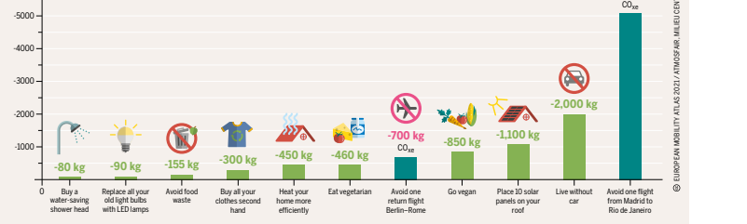

Slide 43
